Slide 1
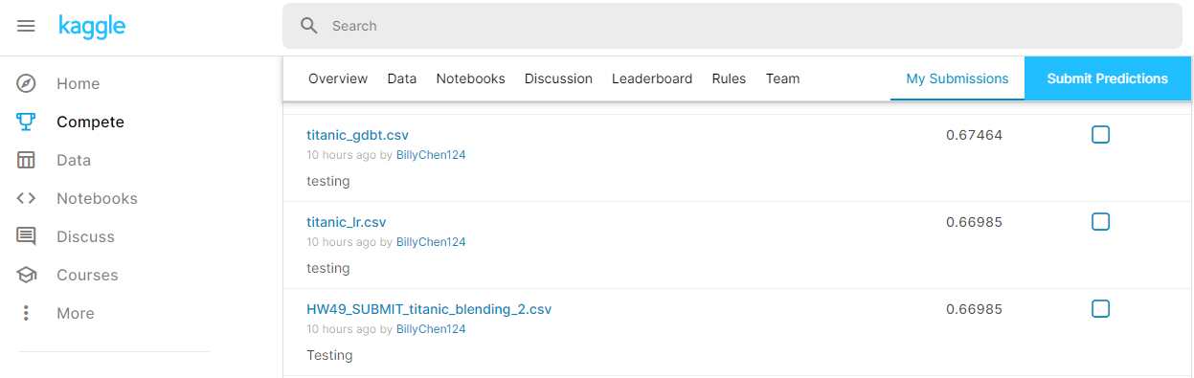
Kaggle Practice

Slide 2
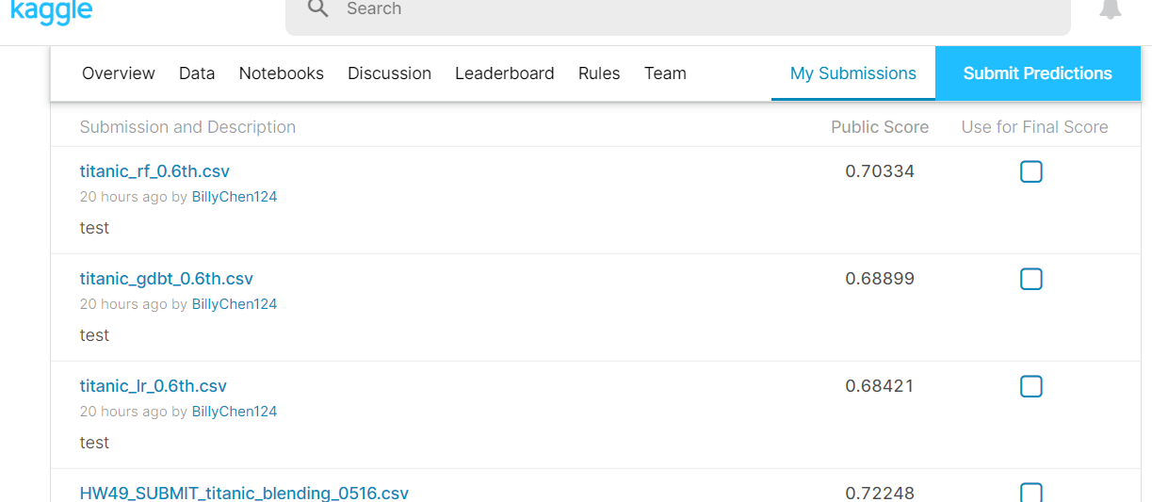
Kaggle Practice-1

